Slide 1

Semantic-Aware searching over Encrypted data for Cloud Computing
Under the Guidance of
Ms.P.S. Latha Kalyampudi
Assistant Professor
Team:
16wh1a1256-B.Sravya
16wh1a1208-B.Manjula
16wh1a1221-K.Ramya

Slide 2
Contents
Introduction
Problem Definition
Literature Survey
Existing System
Proposed System
Architecture Diagram
Module(s)
Plan of Action
References

Slide 3
Introduction
With the increasing adoption of cloud computing, a growing number of users outsource their datasets to cloud.
To preserve privacy, the datasets are usually encrypted before outsourcing. However, the common practice of encryption makes the effective utilization of the data difficult.
A novel semantic search scheme based on the concept hierarchy and the semantic relationship between concepts in the encrypted datasets is being used in this problem statement.

Slide 4
Problem Definition
The difficulty to search the given keywords in encrypted datasets is solved here.
The search schemes provide different query capabilities, including single keyword search, multi-keyword search, fuzzy keyword search, similarity search, and so on.
The semantic relations between words are diverse, such as synonymy and domain correlation.

Slide 5
Literature Survey
A series of efficient search schemes over encrypted cloud data are to be used.
The general process of search scheme can be divided into five steps:
Extracting document features
Constructing a searchable index
Generating search trapdoor
Searching the index based on the trapdoor
Returning the search results.
To improve accuracy, an extended version of concept hierarchy is to be used to expand search conditions.

Slide 6
Existing System & Proposed System
Existing System:
In the stage of extracting document features, the data owner computes the weight of each word in a document and then selects t words with top-t weights as the feature of the document.
During generating search trapdoor, the trapdoor is generated only based on the Search Keywords input by the data user, which is inflexible, because it is impossible to extend the search keywords when the data user cannot express his search intention well.
A search request usually focuses on a theme, and some search words can be considered to be the attribute of the theme.

Slide 7
Proposed System:
This is an efficient searchable encrypted scheme based on concept hierarchy supporting semantic search using two cloud servers.
A concept hierarchy tree is constructed based on domain concepts related knowledge of the outsourced dataset.
The concept hierarchy is used to include more semantic relations using concepts.
Document features are extracted more precisely and search terms are well extended based on the semantic relations between concepts.

Slide 8
For each document, two index vectors are generated, one is used to match concepts in the search request and another one is used to determine whether the value for an attribute is satisfied with the search request.
Correspondingly, the search trapdoor for a search request also includes two vectors. Using two cloud servers can save much time in search.
Cloud server B used to compute the similarity between the documents vector and the trapdoors vector.
Cloud server Ais used to rank results and return them to users.

Slide 9
Modules
Data Owner:
Upload data
View Data
Key request
Data Users:
Search
Cloud Server A:
Outsourced Data
Response to Users
Cloud Server B:
Trapdoors

Slide 10
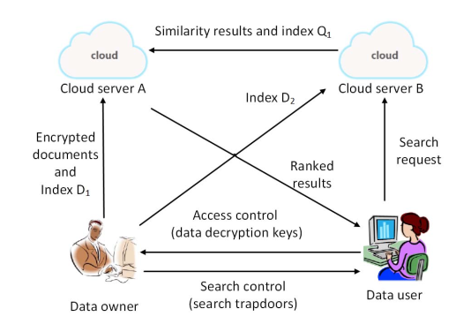
Architecture Diagram

Slide 11
The Web application is implemented through AWS cloud services and URL is provided which can be accessed from multiple devices.
https://signin.aws.amazon.com/signin?redirect_uri=https%3A%2F%2Fportal.aws.amazon.com%2Fbilling%2Fsignup%2Fresume&client_id=signup
URL: http://semanticsearch-env.eba-apwfsek2.us-east-2.elasticbeanstalk.com/

Slide 12
AWS services:
RDS (MySQL) :In this service we can create database for storing the application data and generate data base endpoint for connecting MySql data base from our application.
Elastic Beanstalk : AWS Elastic Beanstalk is an easy-to-use service for deploying and scaling web applications and services developed with Java and servers such as Apache Tomcat.

Slide 13
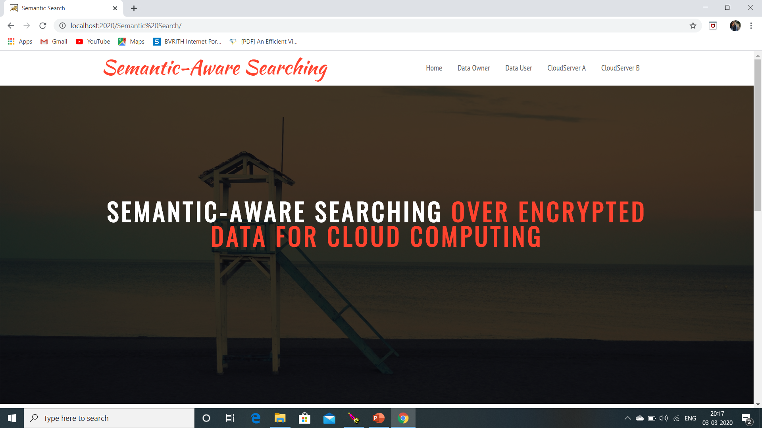
Home page

Slide 14
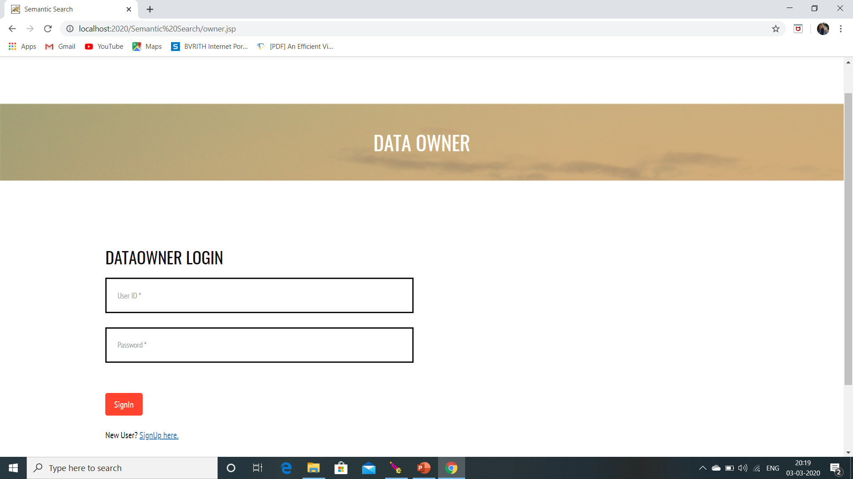
Data owner login/ register.

Slide 15
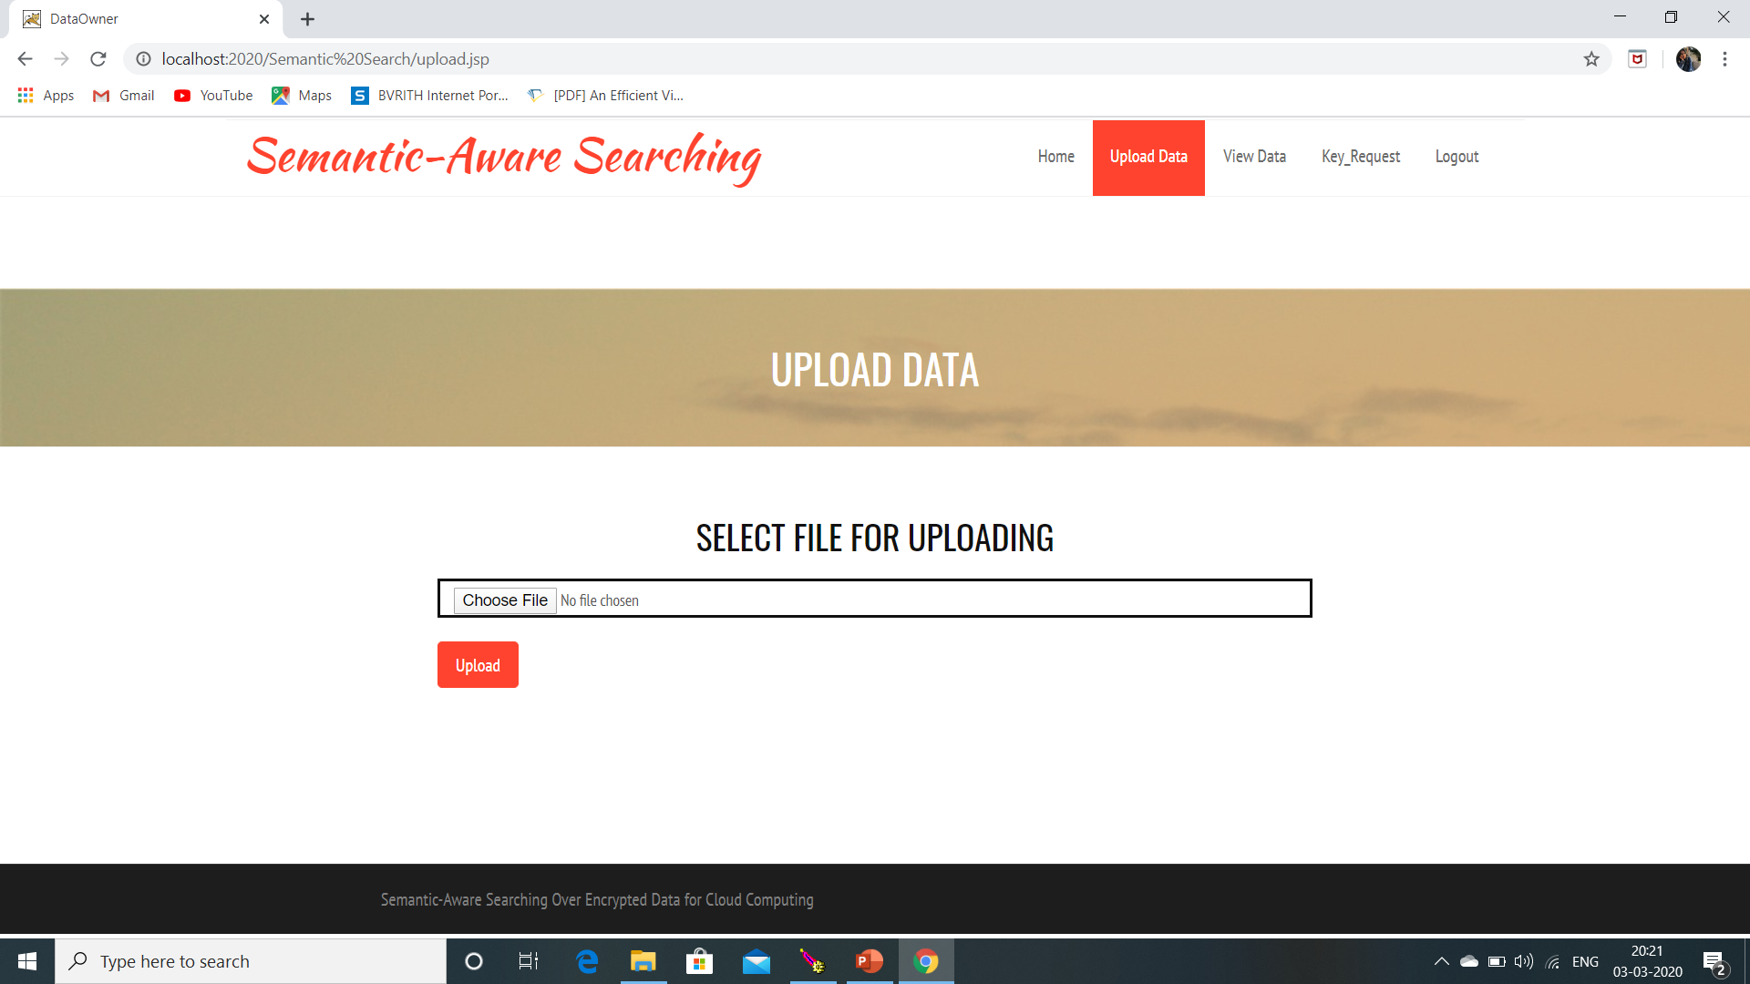

Slide 16
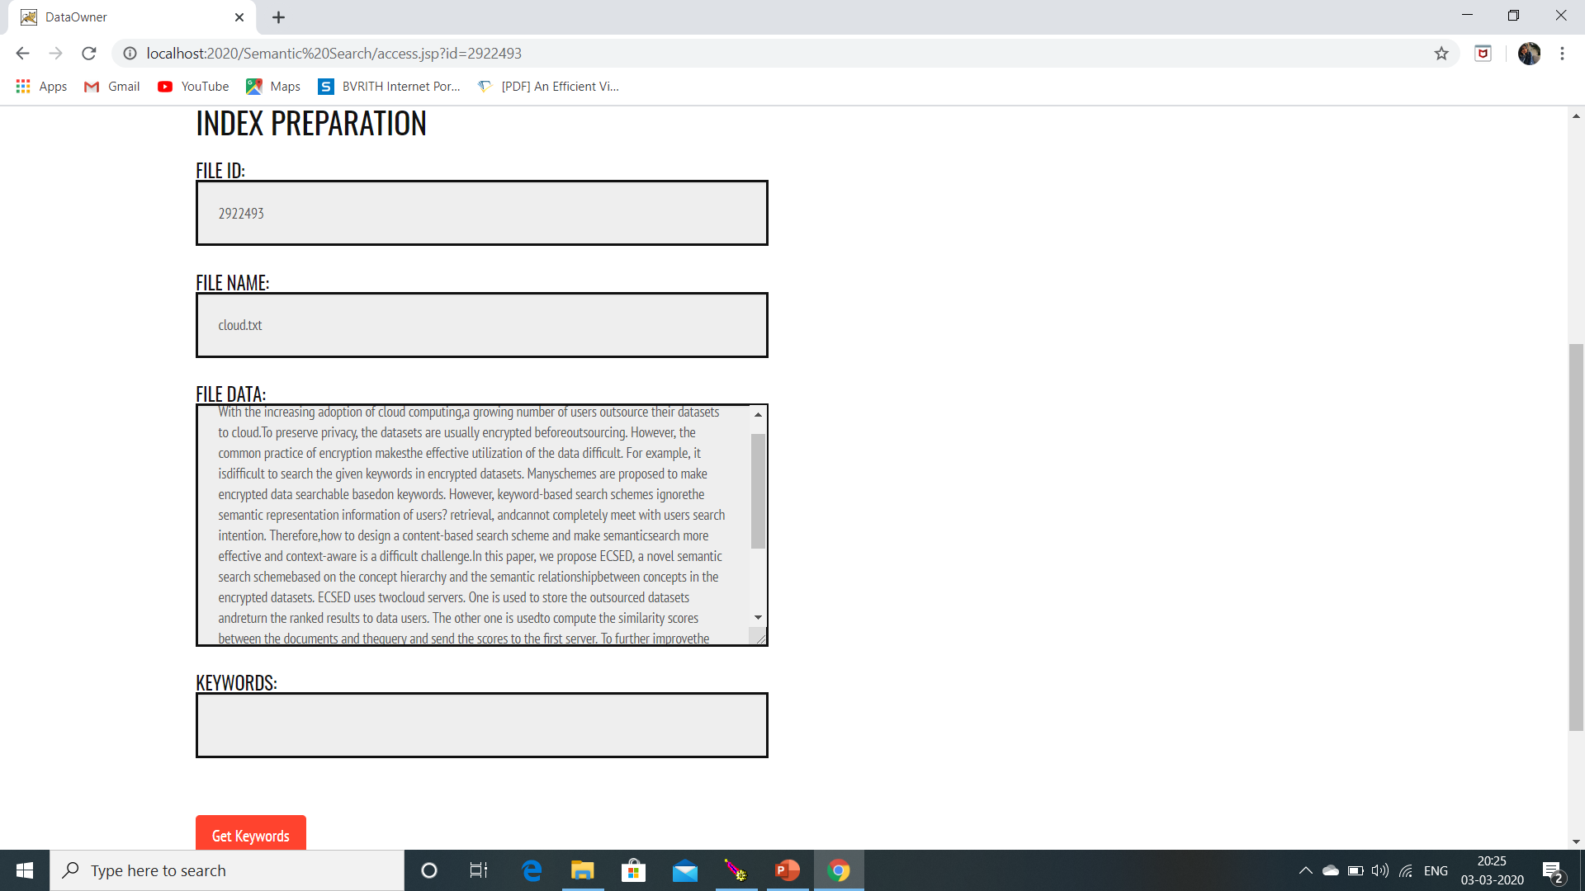

Slide 17
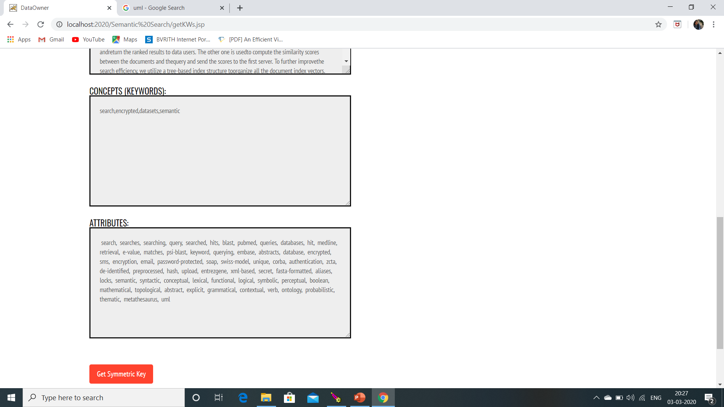

Slide 18
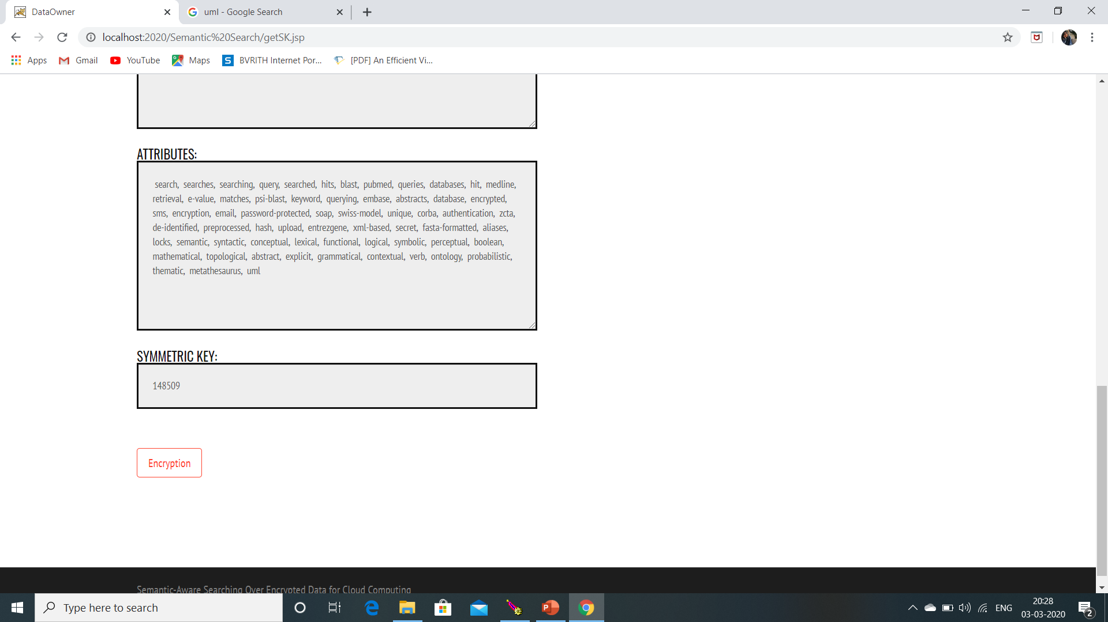

Slide 19
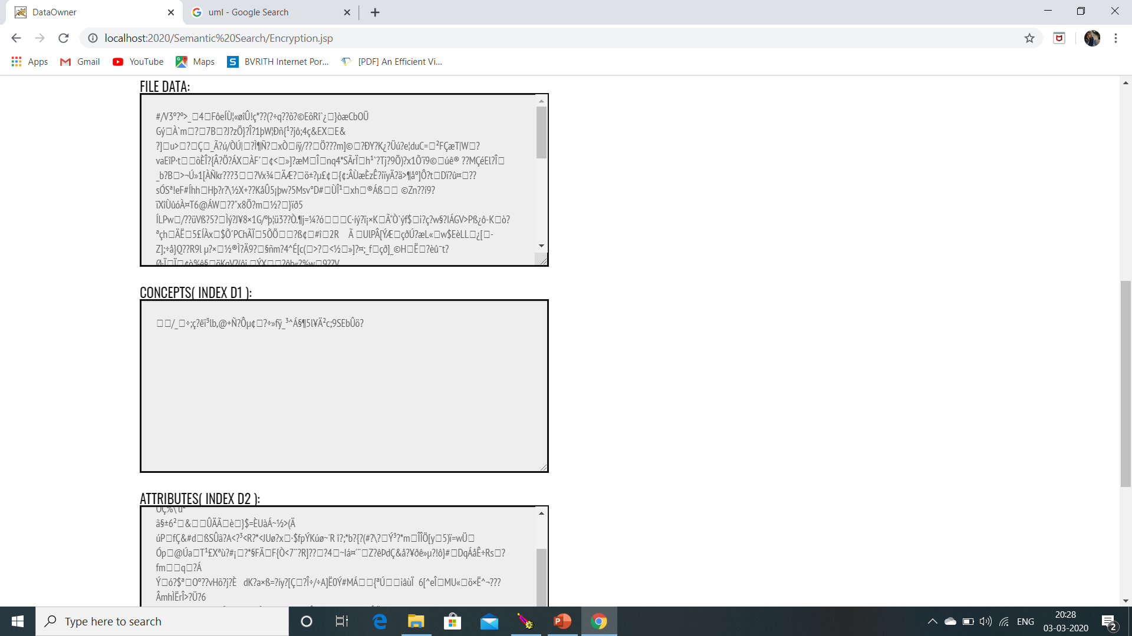

Slide 20
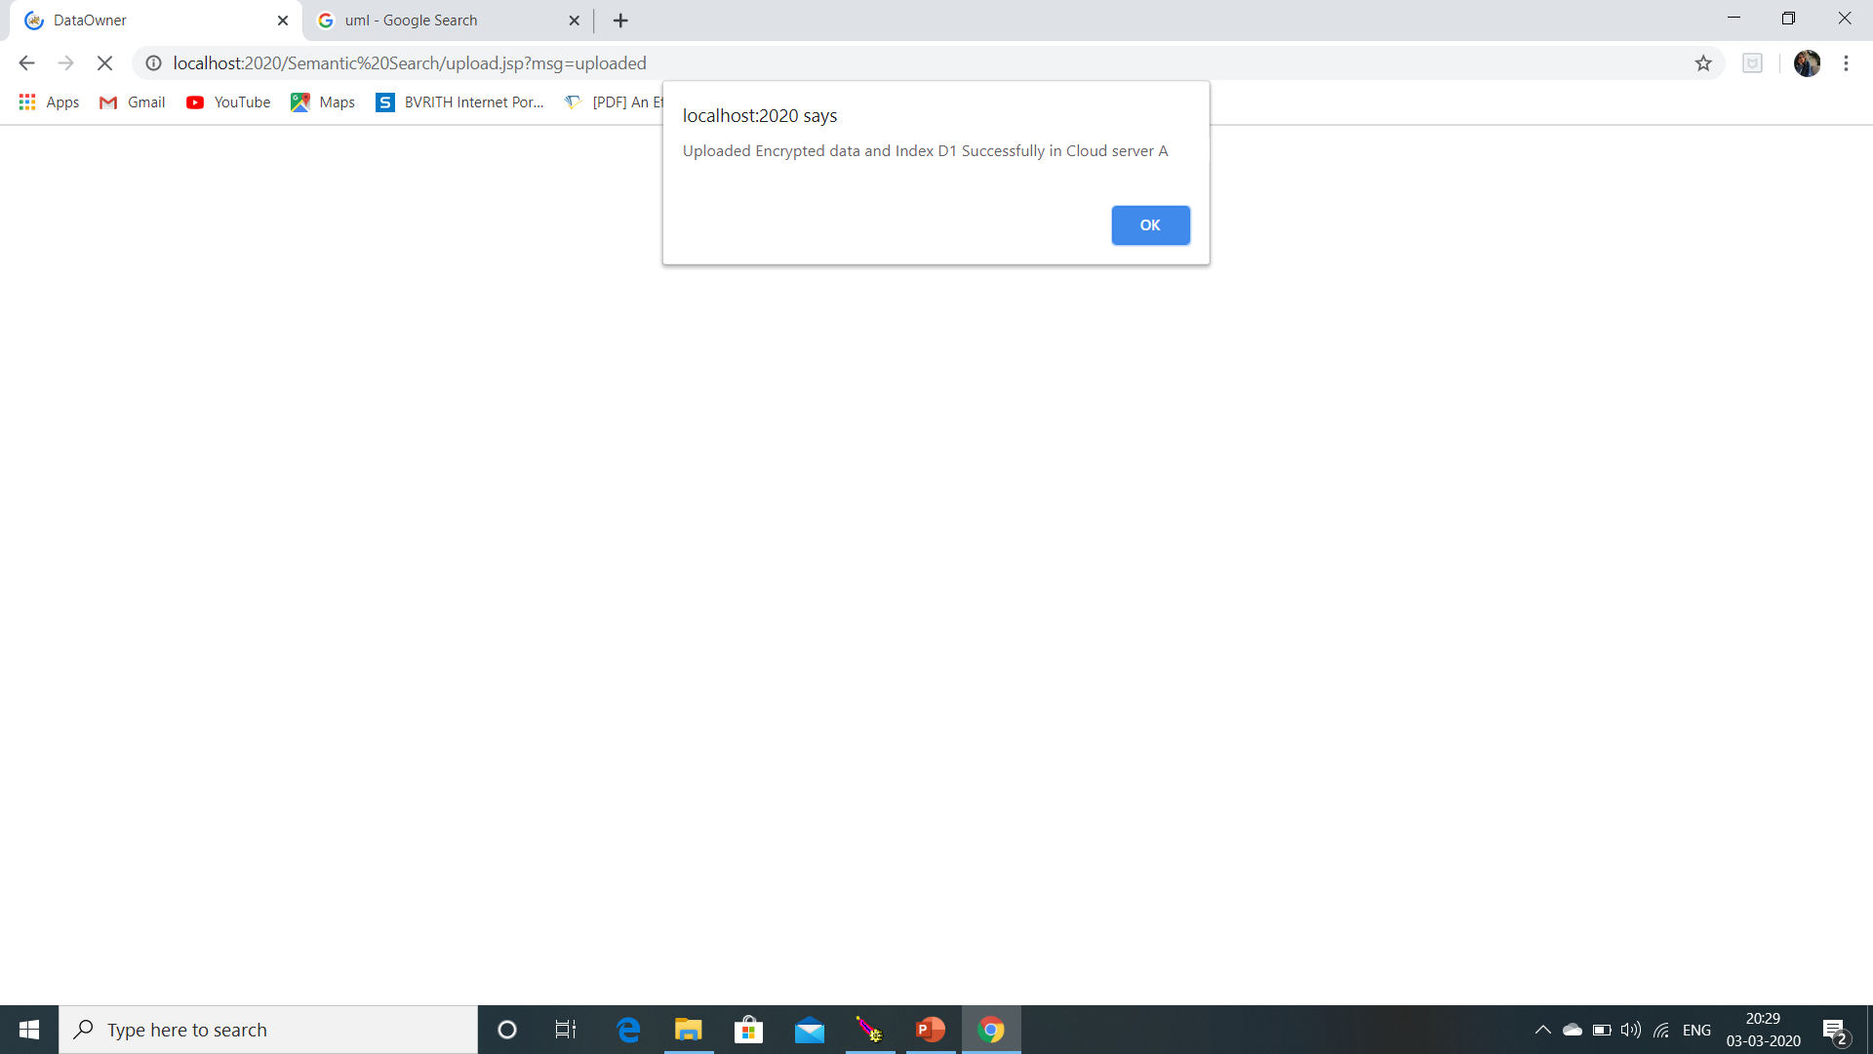
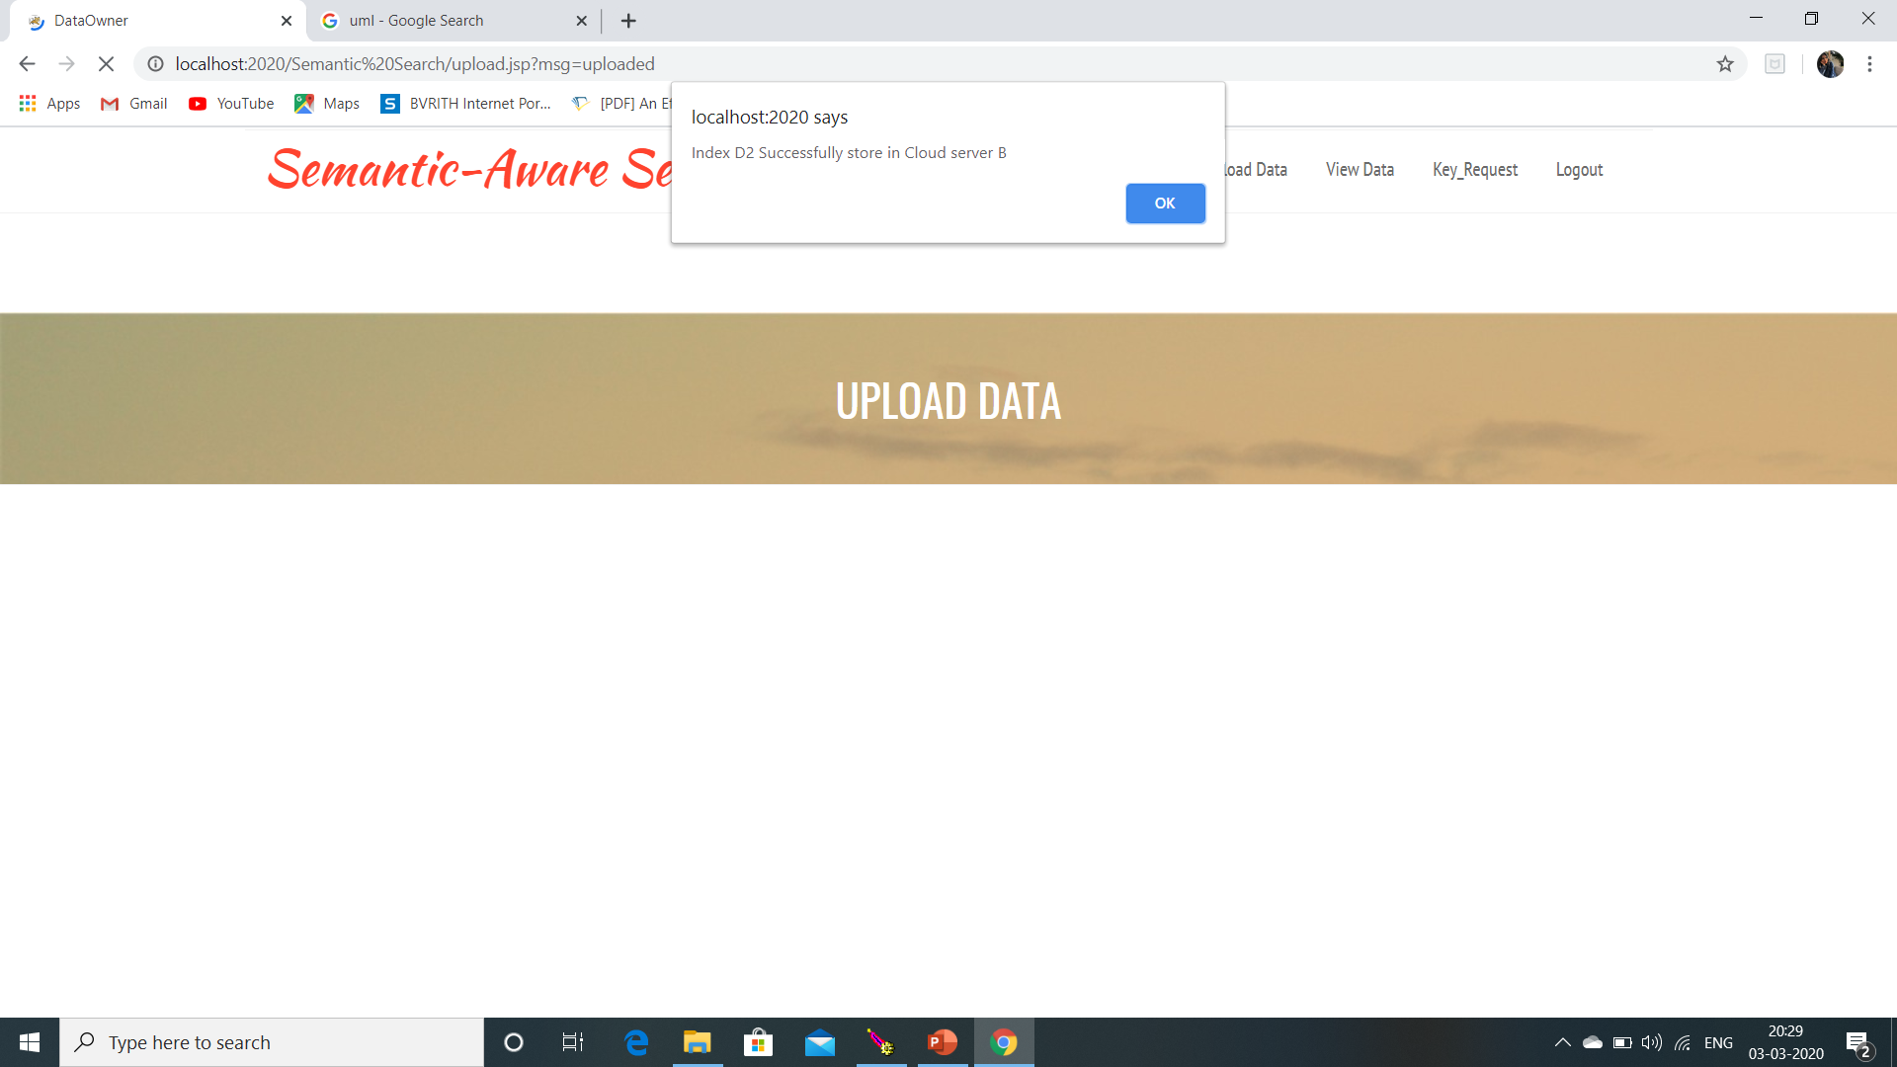

Slide 21
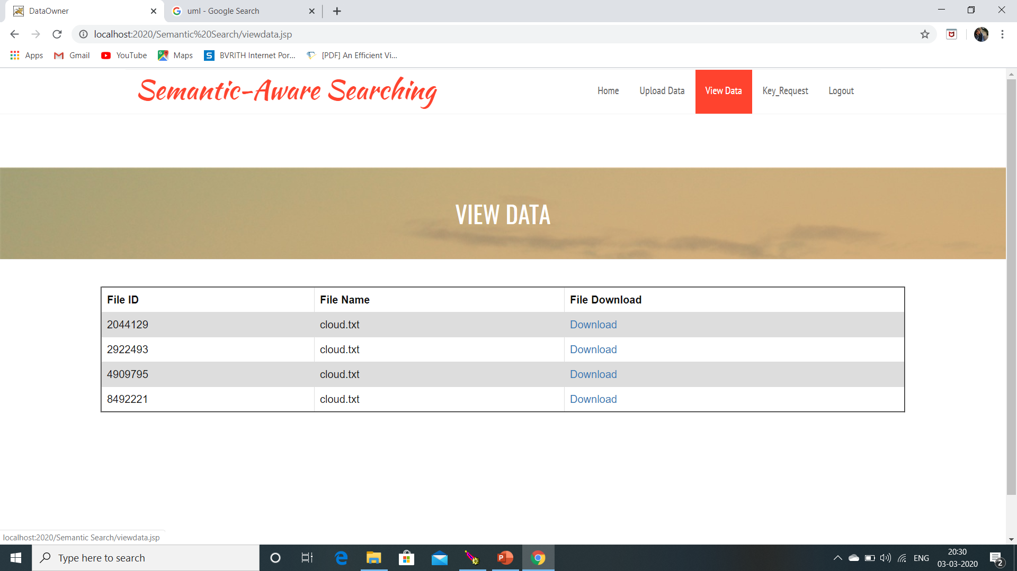
To eliminate this redundancy we have used SHA-256.

Slide 22
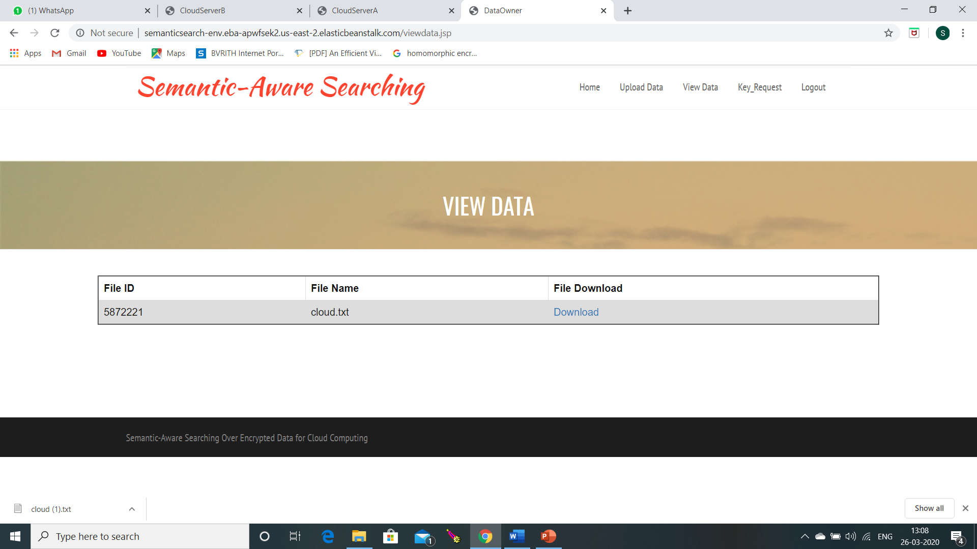
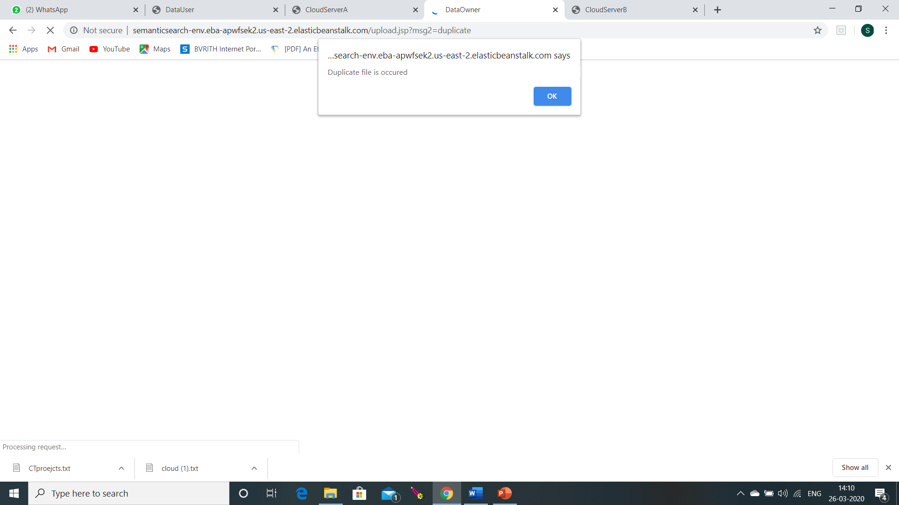

Slide 23
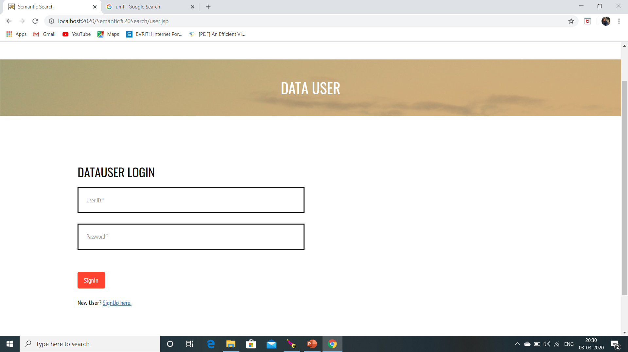

Slide 24
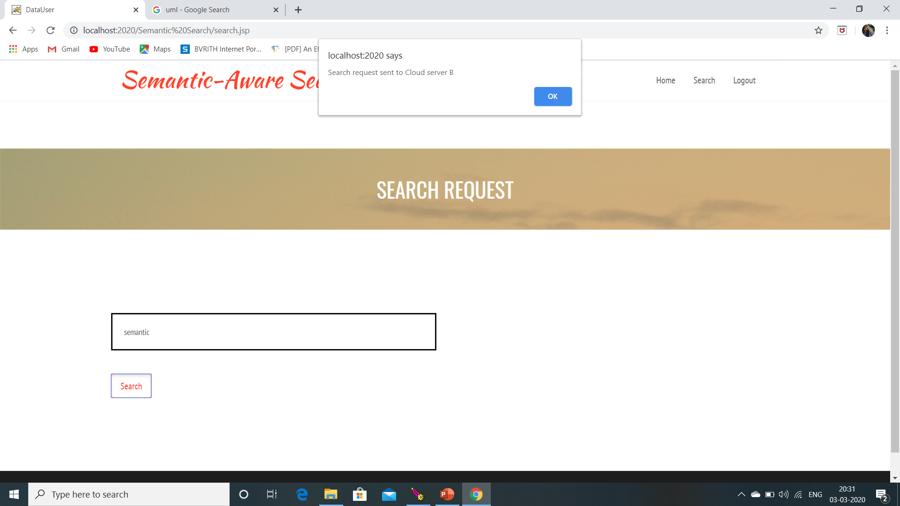

Slide 25
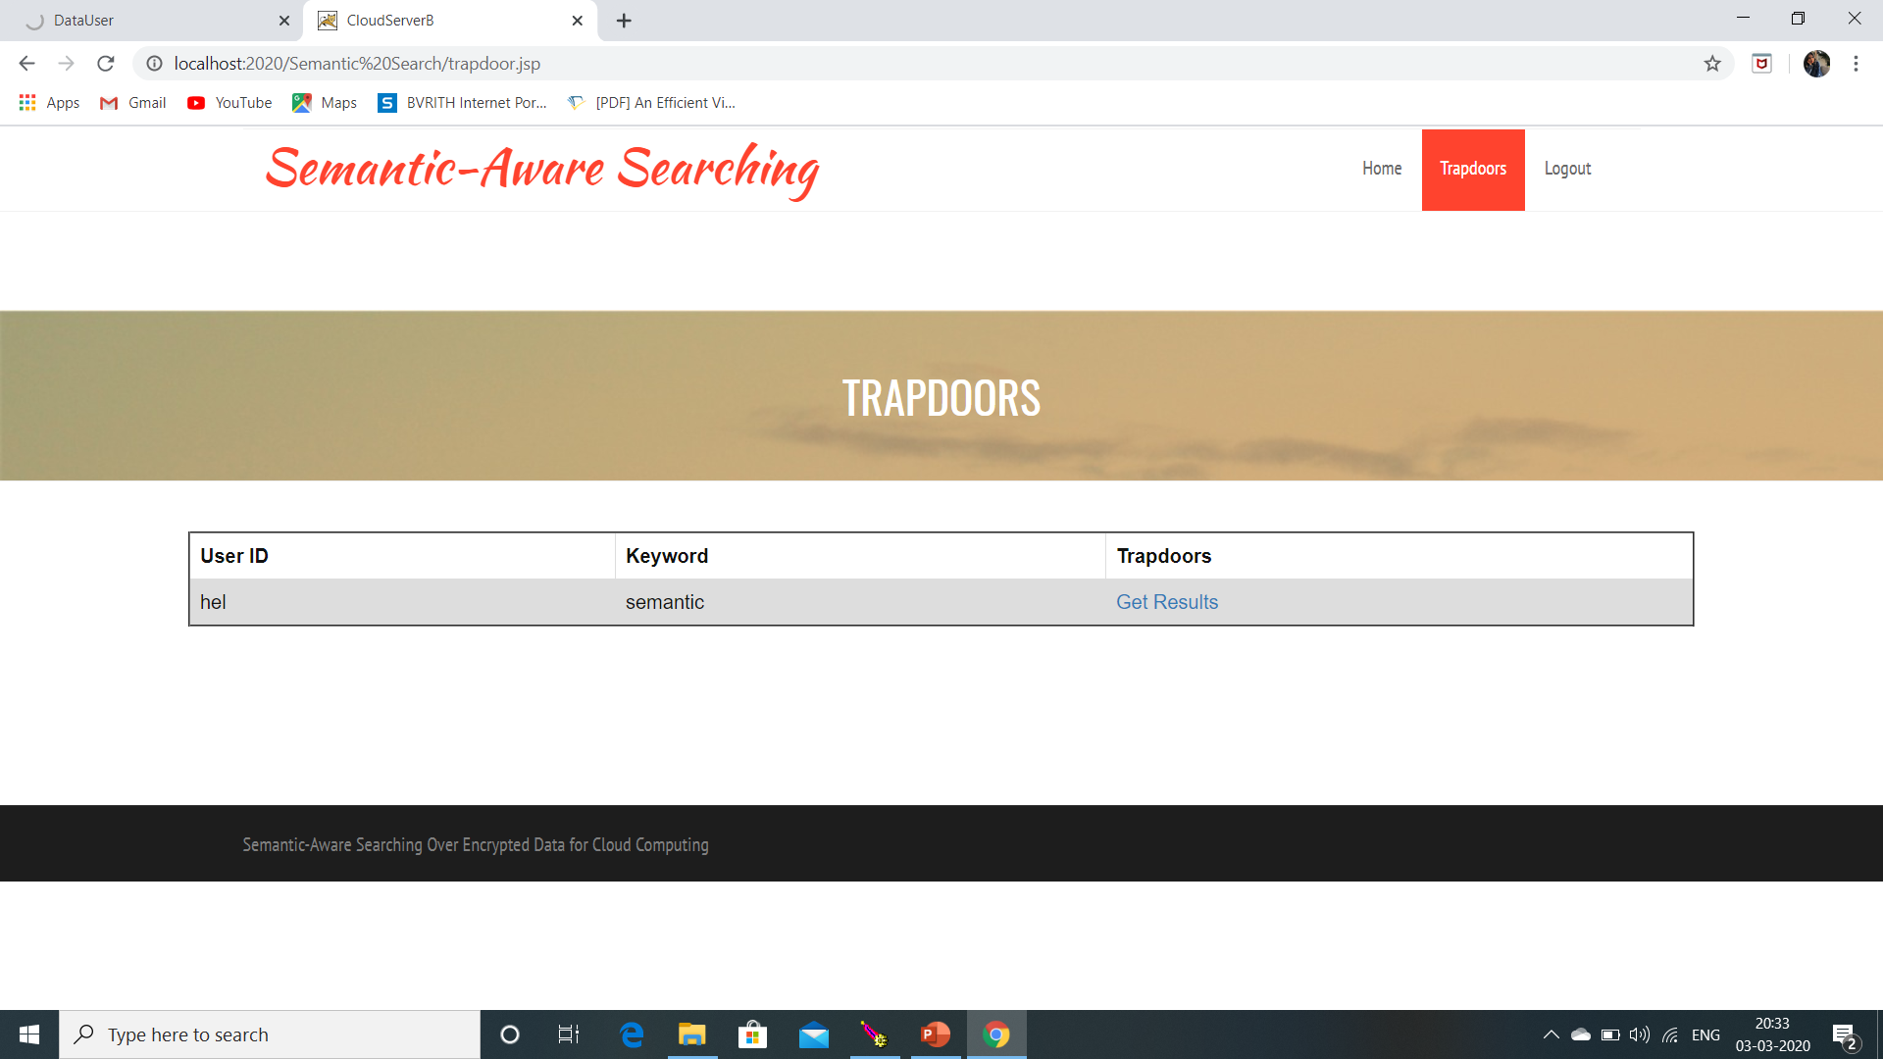

Slide 26
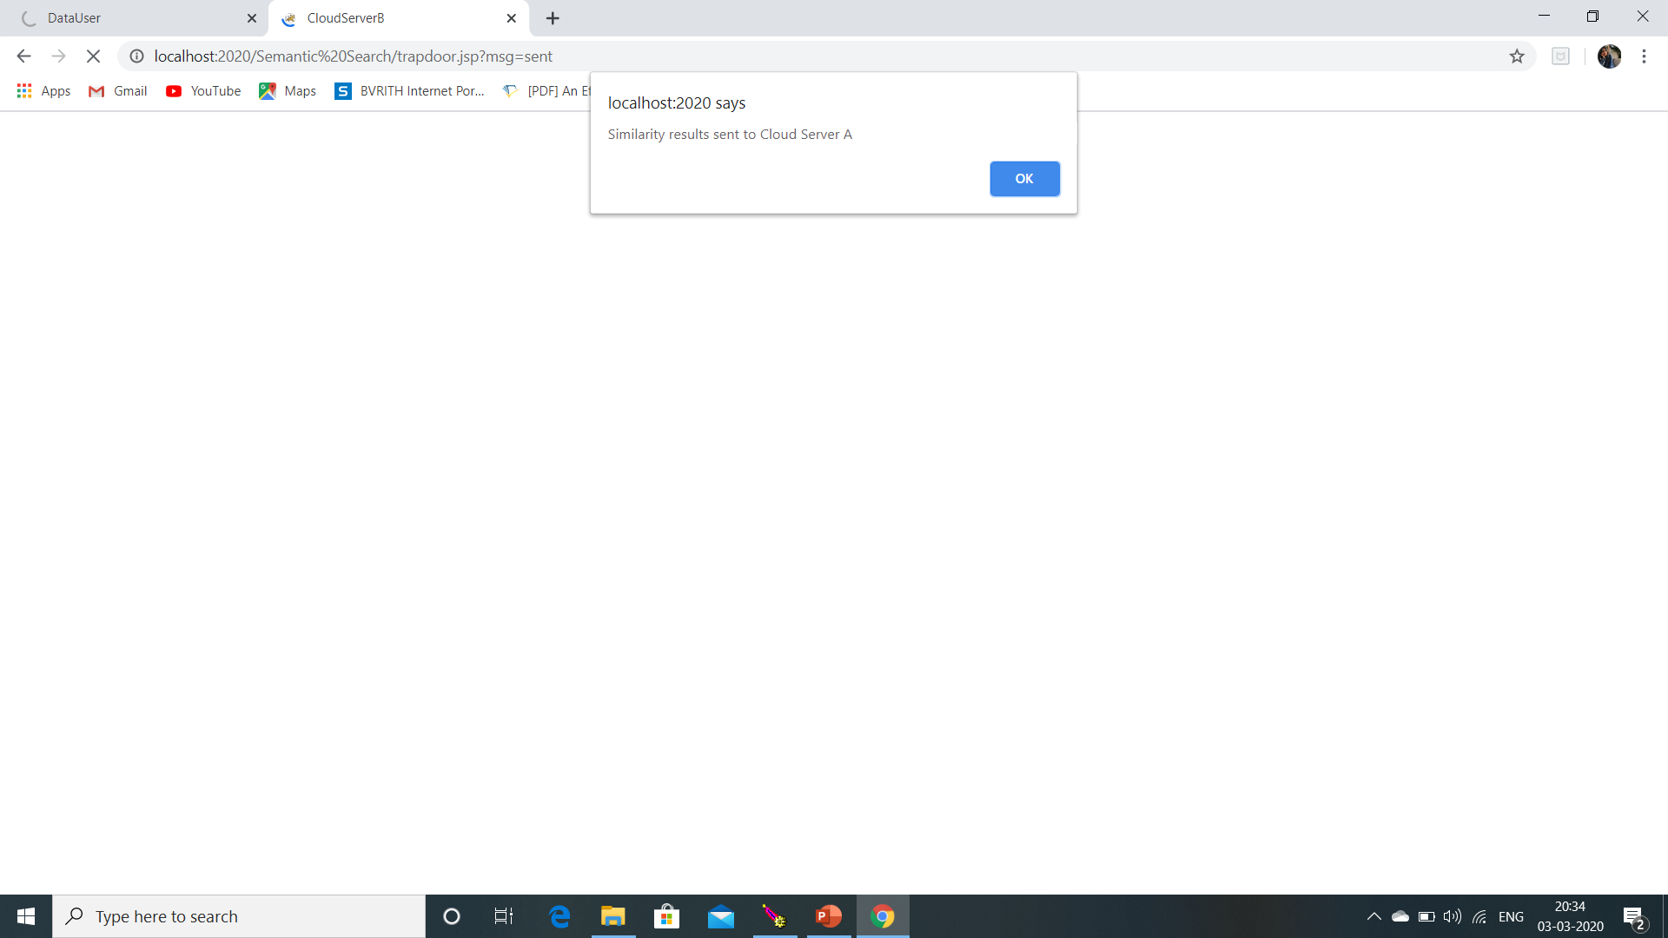

Slide 27
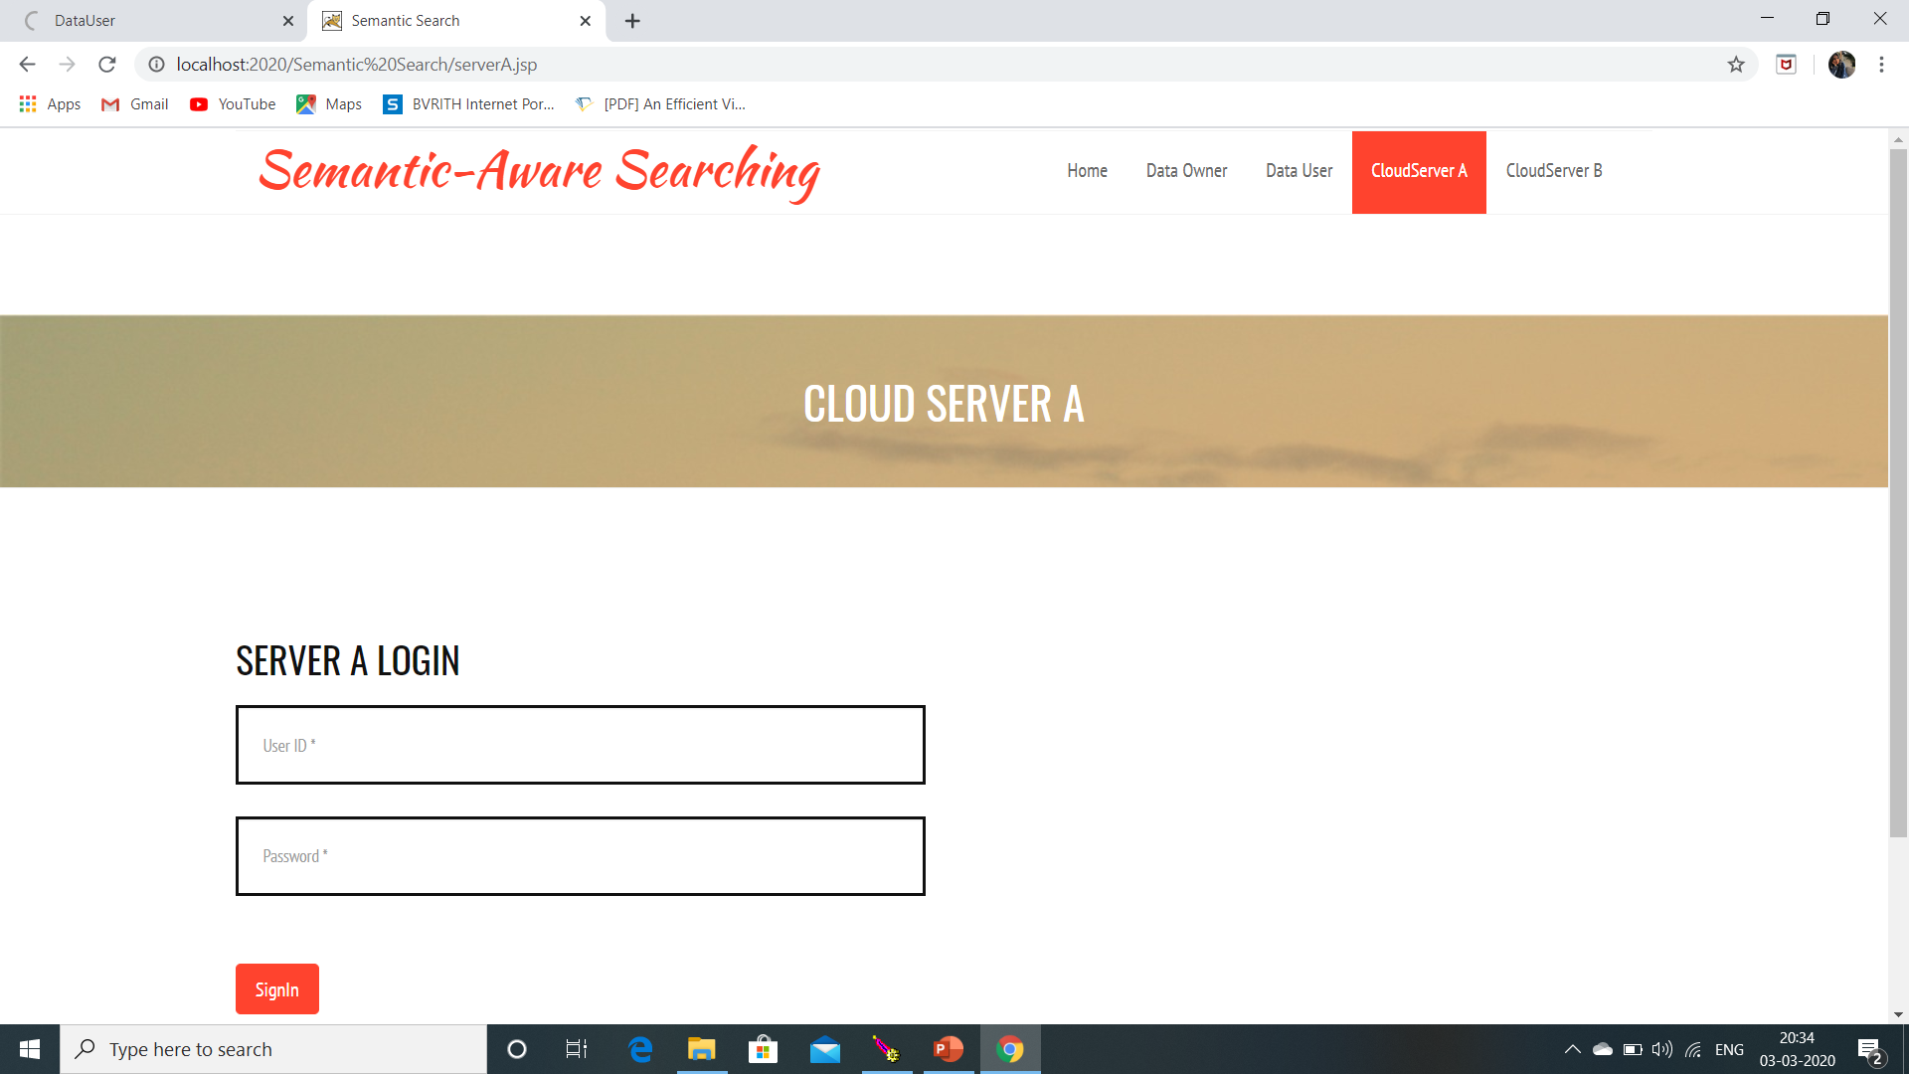

Slide 28
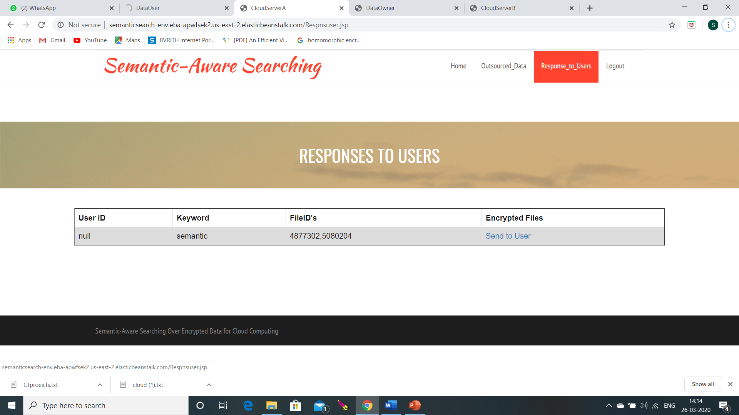
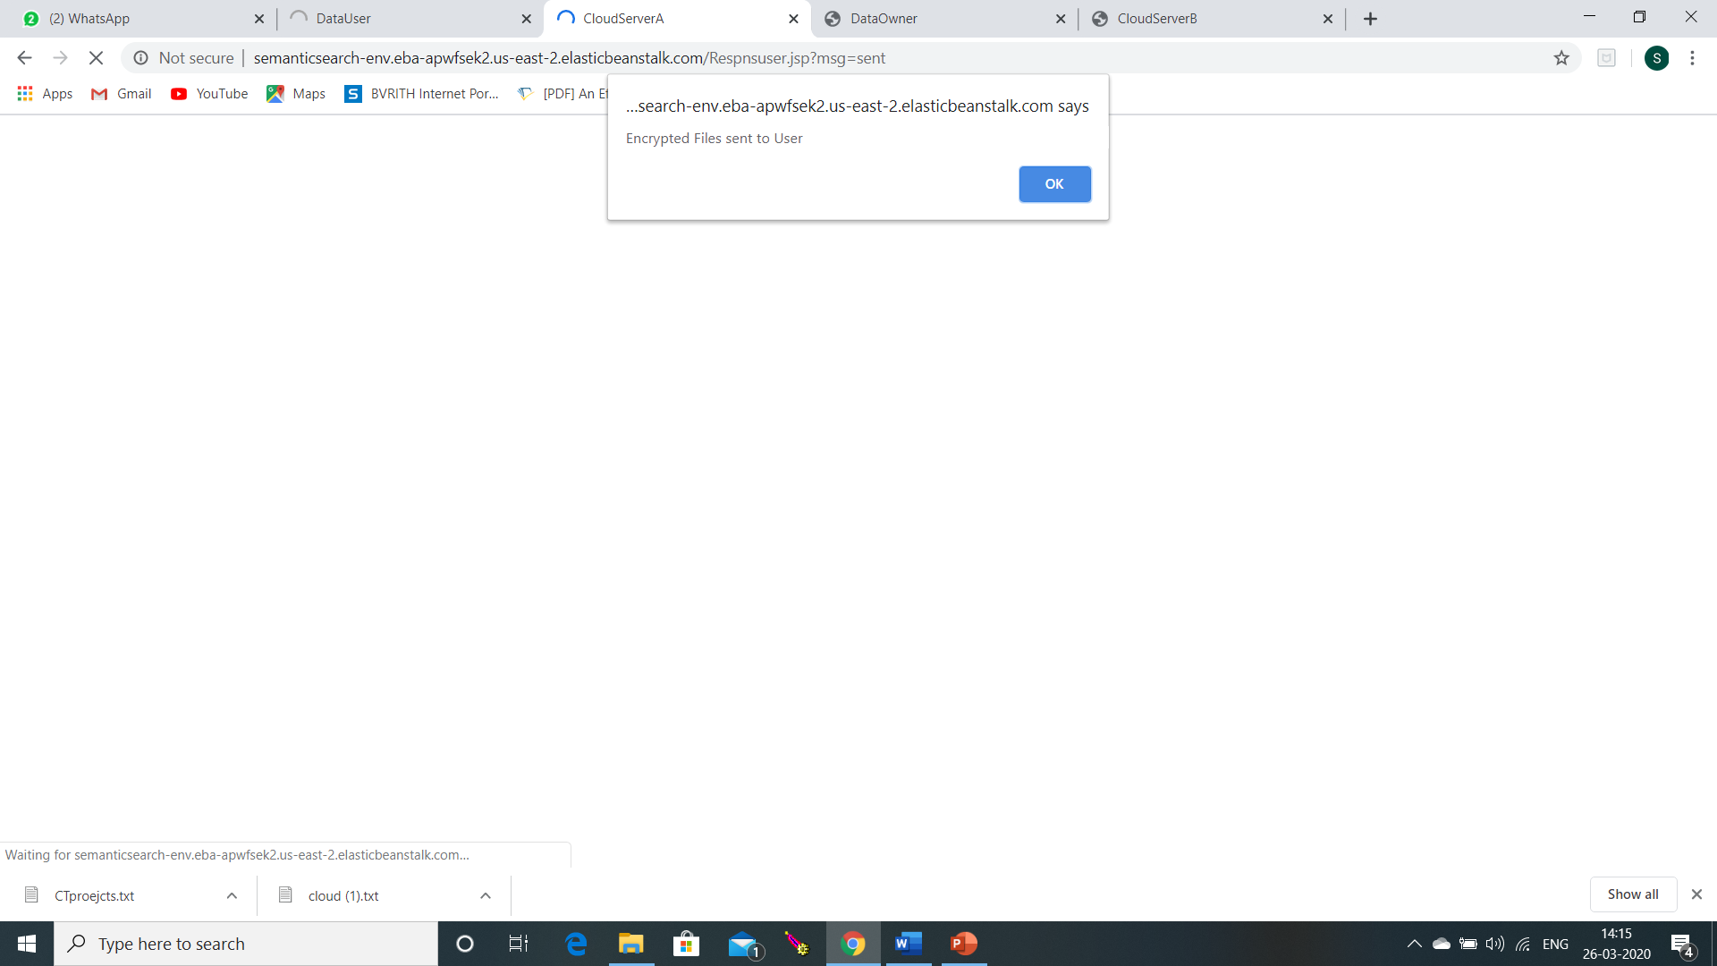

Slide 29
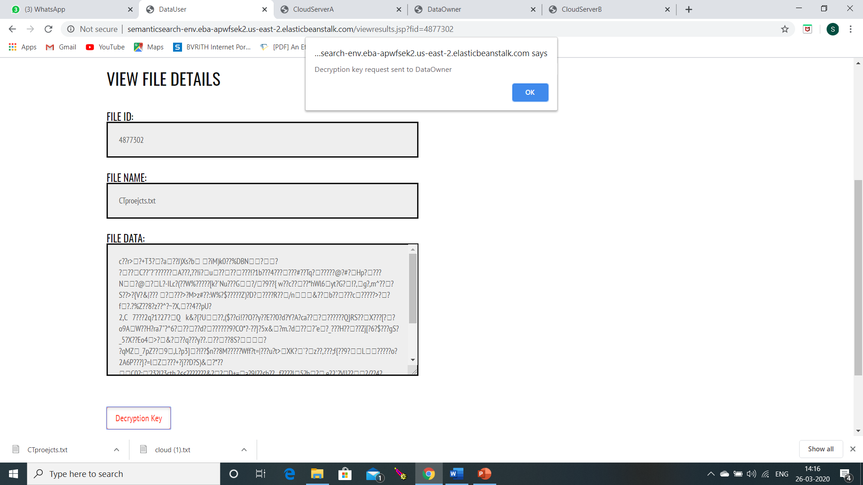
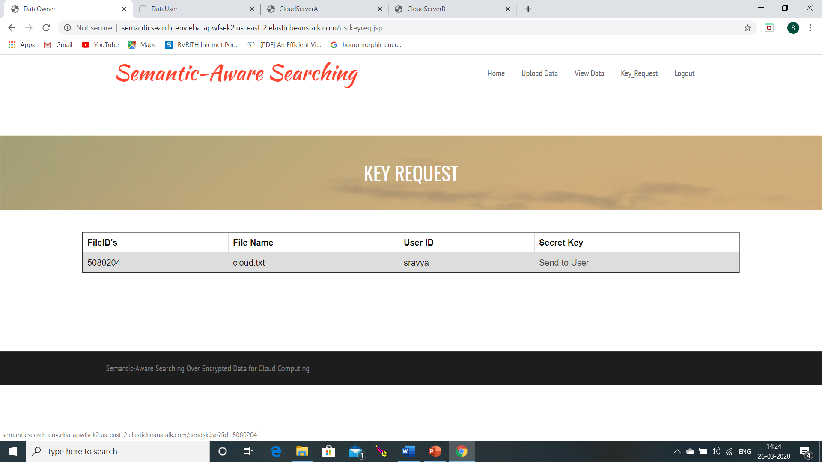

Slide 30
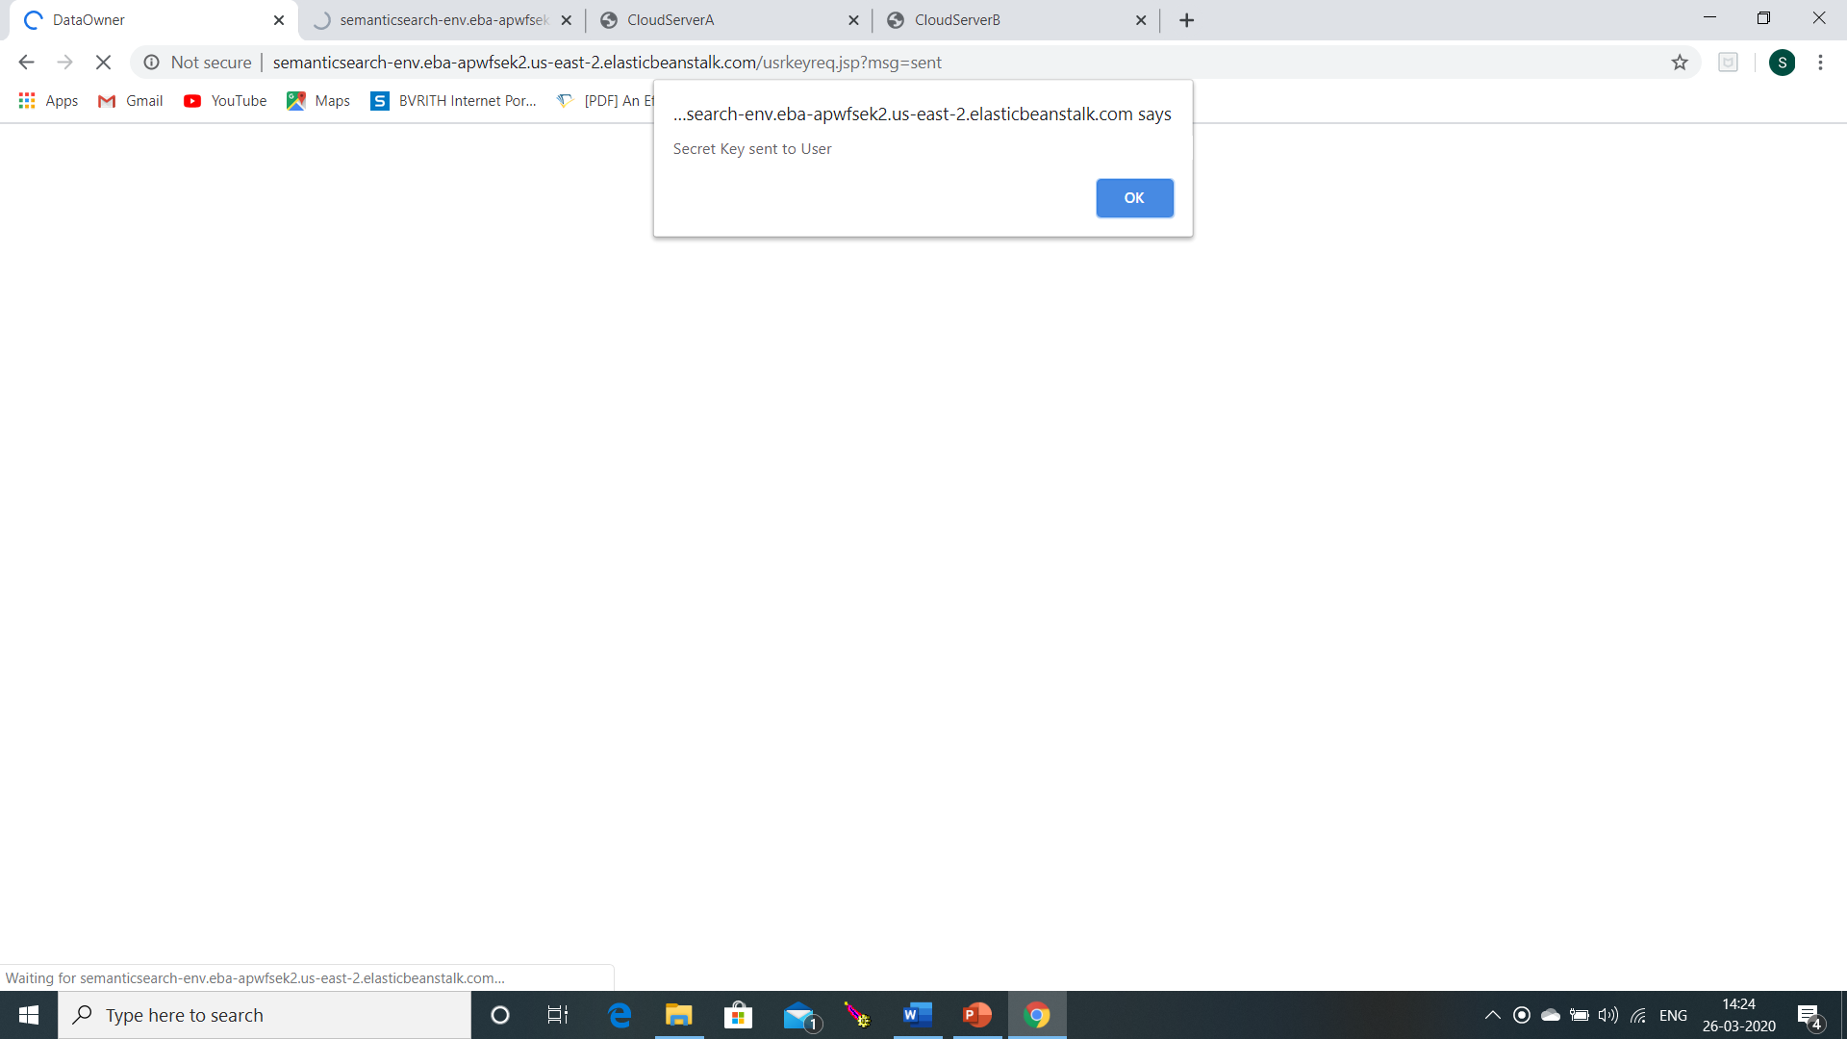
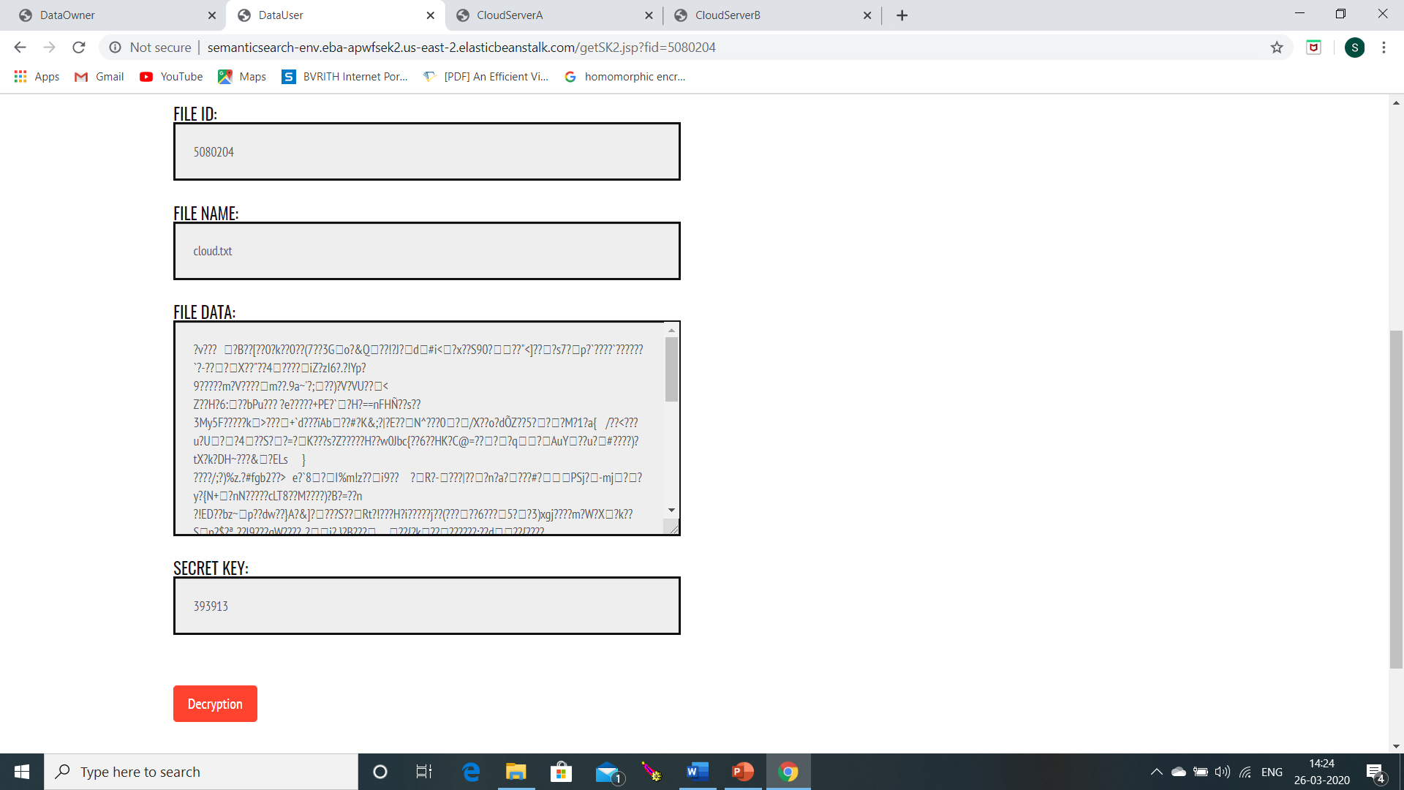

Slide 31
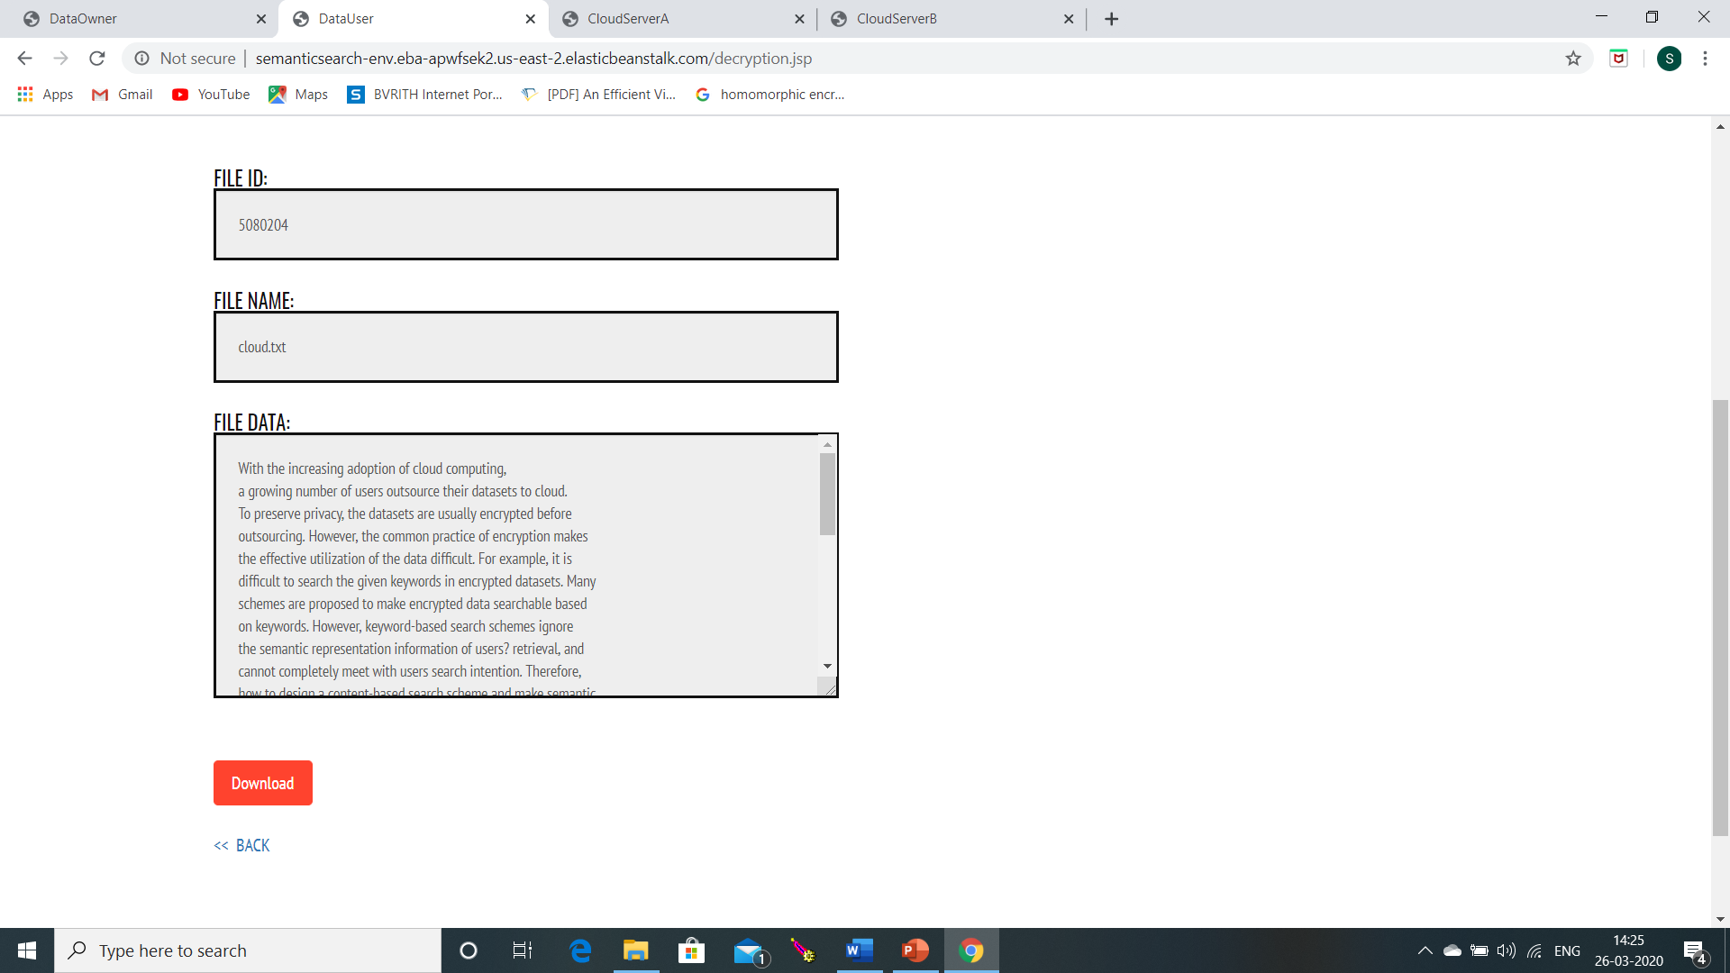

Slide 32
Project flow: ..\Downloads\video-1585239804.mp4

Slide 33
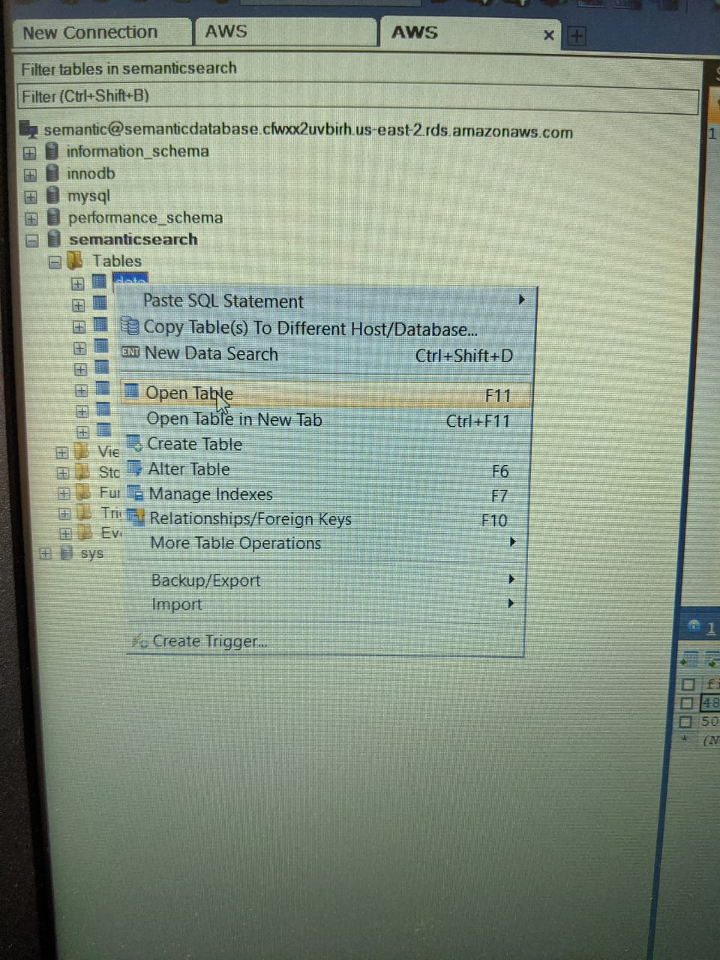
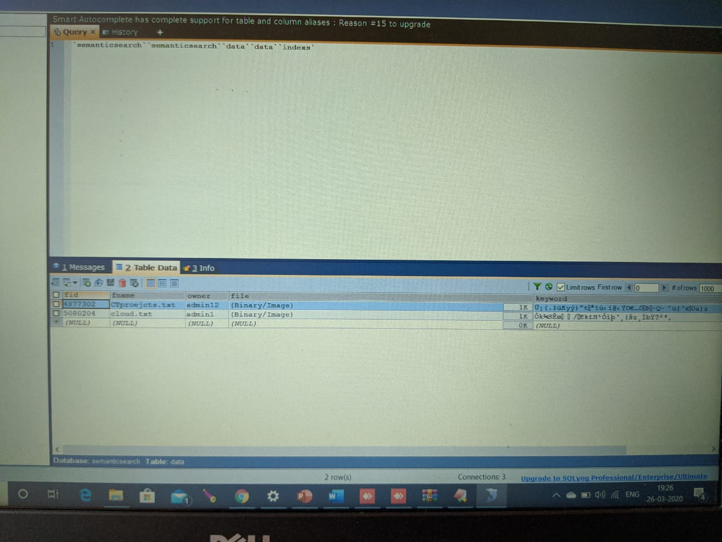
Data stored:

Slide 34
Action Plan
Example as:
Module Information | Status | Time required to Complete
Literature Survey | Done. | -
Requirement Analysis | Done. | 1 Week
Design | Done. | 2 Weeks
Implementation | Done. | 4 Weeks
Documentation | Done. | 2 Weeks
Final Submission

Slide 35
References
[1] Zhangjie Fu, Lili Xia, Xingming Sun, Alex X. Liu, “Semantic-Aware Searching Over Encrypted Data for Cloud Computing”, ieee transactions on information forensics and security, vol. 13, no. 9, September 2018.
[2] L. M. Vaquero, L. Rodero-Merino, J. Caceres, and M. Lindner, “A break in the clouds: Towards a cloud definition,” ACM SIGCOMM Comput. Commun. Rev., vol. 39, no. 1, pp. 50–55, 2008.
[3] C. Wang, N. Cao, K. Ren, and W. Lou, “Enabling secure and efficient ranked keyword search over outsourced cloud data,” IEEE Trans. Parallel Distrib. Syst., vol. 23, no. 8, pp. 1467–1479, Aug. 2012.
[4] D. X. Song, D. Wagner, and A. Perrig, “Practical techniques for searches on encrypted data,” in Proc. SP, 2000, pp. 44–55.
[5] R. Curtmola, J. A. Garay, S. Kamara, and R. Ostrovsky, “Searchable symmetric encryption: improved definitions and efficient constructions,” in Proc. ACM CCS, 2006, pp. 79–88.
[6] A. Swaminathan et al., “Confidentiality-preserving rank-ordered search,” in Proc. ACM Workshop Storage Secur. Survivability, 2007, pp. 7–12.
[7] S. Zerr, D. Olmedilla, W. Nejdl, and W. Siberski, “Zerber+R: Top-k retrieval from a confidential index,” in Proc. EDBT, 2009, pp. 439–449.
[8] N. Cao, C. Wang, M. Li, K. Ren, and W. Lou, “Privacy-preserving multi-keyword ranked search over encrypted cloud data,” IEEE Trans. Parallel Distrib. Syst., vol. 25, no. 1, pp. 222–233, Jan. 2014.

Slide 36
THANK YOU

